Slide 1
Craft Brewery Location
Gabriel X. Martinez
gmartinez@avemaria.edu

Slide 2
Where should you locate your new Brewery?
Increasing interest in craft brewing.
Do you want to start your own brewery? How can you raise your chances of success?
Find neighborhoods that are underserved by breweries: given their market characteristics, they should have more breweries than they currently have.

Slide 3
Where should you locate your new Brewery?
To identify which cities “should” have a high number of breweries, focus on
High average incomes
Large number of jobs per person
High levels of education
High population and housing density
Enough younger people
Enough of a craft-beer culture to generate a critical mass of interest.

Slide 4
Data
Get data from
Foursquare
The Bureau of the Census
Limitations
The biggest limitation of this study is that it relied on a free version of Foursquare, which limits to 50 results per search. In practical terms, this means that we only get 50 breweries per MSA. The obvious solution is to redefine the geographical area to be a zip-code or a census-tract.
Calculate
Brewery Density, as a proportion of the number of people (breweries per 100,000 people) and of the size of the city (breweries per 100 square miles).

Slide 5
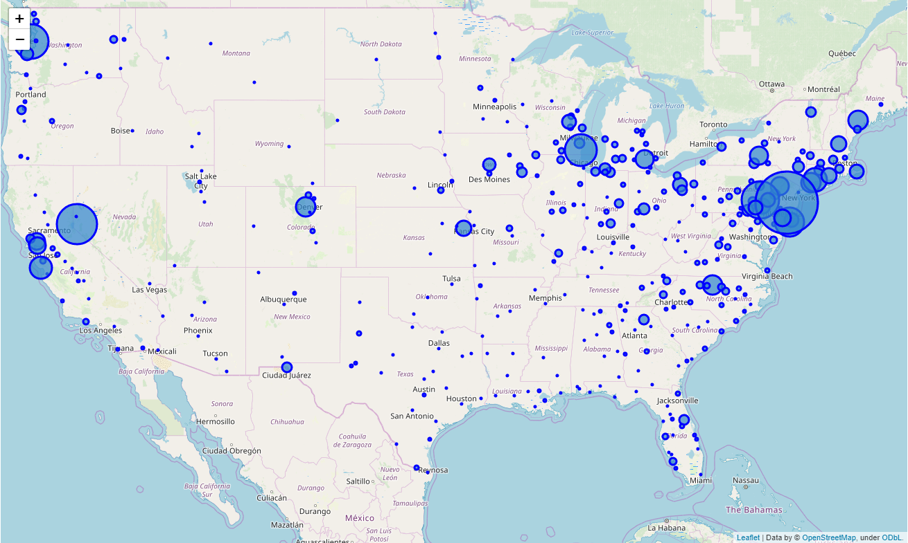
Density of Breweries per 100 square Miles

Slide 6
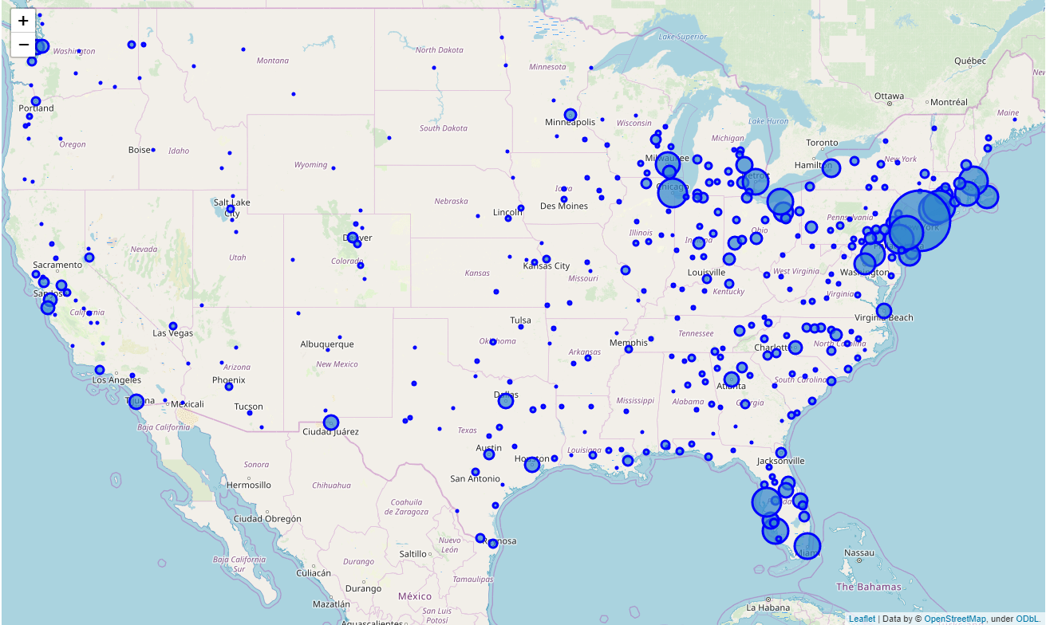
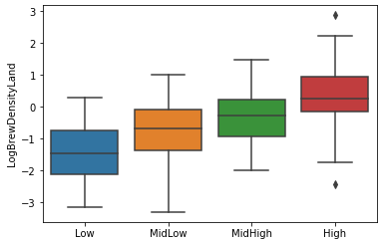
Housing Density

Slide 7
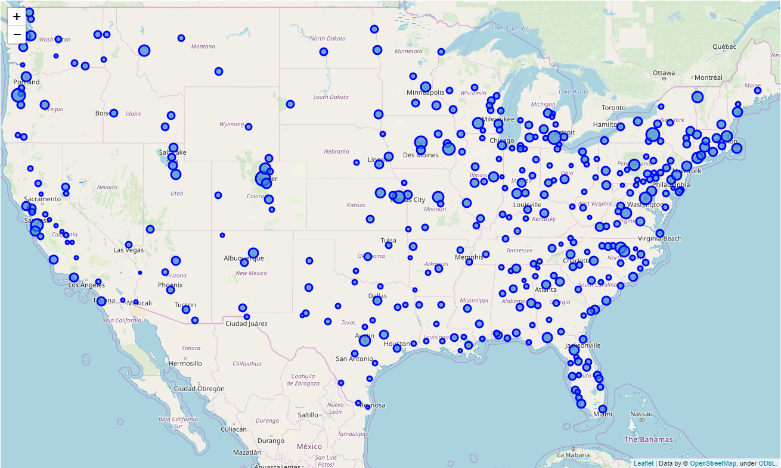
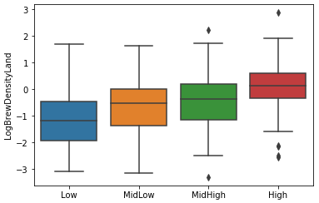
Proportion of 25+ year olds with at least a Bachelor’s

Slide 8

Model to be estimated
$$Log of BrewDensityLand= \\ β_{0} \\ +β_{1}JobsPopulation Ratio \\ +β_{2}\% of over25 with more than Bachelor^{′}s \\ +β_{3}HousingDensity \\ +β_{4}BarsDensityLand \\ +ε$$

Slide 9
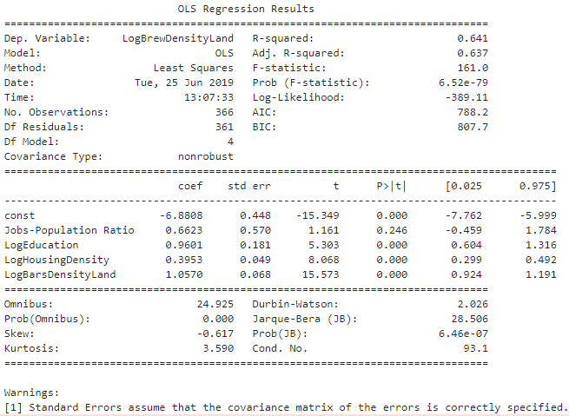
Results
Education, housing density, and the existence of other night-life establishments are strong predictors of the presence of craft breweries.

Slide 10
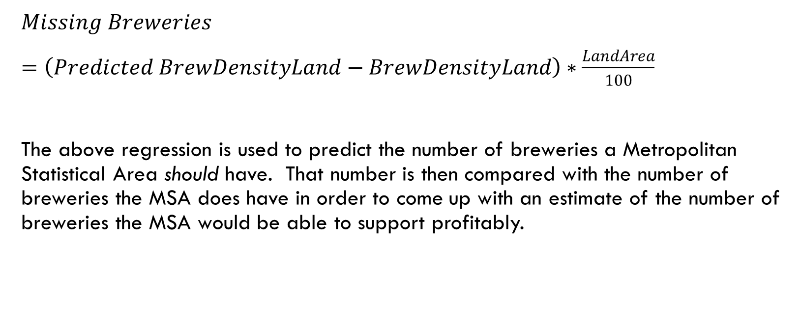
Missing Breweries
$Missing Breweries$
$=\left(Predicted BrewDensityLand−BrewDensityLand\right)∗\frac{LandArea}{100}$
The above regression is used to predict the number of breweries a Metropolitan Statistical Area should have. That number is then compared with the number of breweries the MSA does have in order to come up with an estimate of the number of breweries the MSA would be able to support profitably.

Slide 11
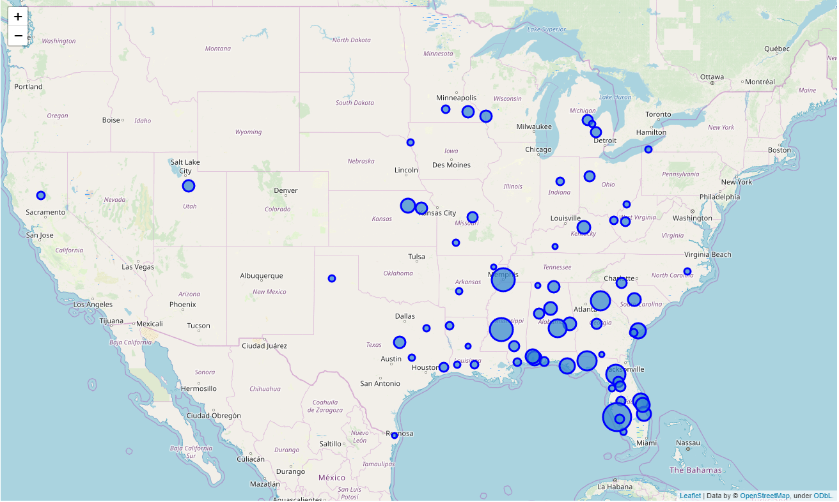
Results
The majority of “missing breweries” are located in the Southeast.
This map identifies the MSAs that have at least 4 “missing breweries” but fewer than 20 actual breweries.

Slide 12
Results
GeoName | Missing Breweries | Existing Number of Breweries
North Port-Sarasota-Bradenton, FL | 21.94 | 5
Jackson, MS | 18.48 | 1
Memphis, TN-MS-AR | 18.37 | 7
Gainesville, FL | 15.48 | 7
Tallahassee, FL | 15.16 | 6
Athens-Clarke County, GA | 14.57 | 4

Slide 13
Conclusions
What are the determinants of craft brewery location in metropolitan statistical areas of the United States? Where should you locate your brewery?
Income, jobs, age, and gender are generally poor predictors, while housing (and population) density and educational attainment tend to predict brewery location fairly well.
We identified nearly 70 MSAs that would provide fertile ground for new-brewery location.

